Slide 1


Intrusion Detection System Using Deep Neural Network for In-Vehicle Network Security
UNB
Nasrin Eshraghi Ivari

Slide 2
Table of content
Introduction
EDU
CAN
Previous work
Intrusion Detection with Machine Learning
Deep Learning for Classification
Deep Belief Network
Proposed method with DNN
Conclusion

Slide 3
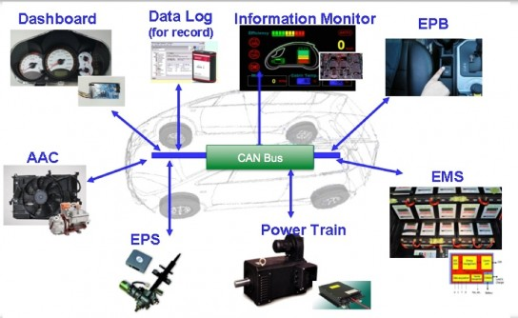
INTRODUCTION Electronic Control Unit-ECU
An Electronic Control Unit (ECU) is any embedded system in automotive electronics that controls and monitors one or more of the electrical systems or subsystems in a vehicle.(like BIOS) → via sensors
Many different types of ECUs, including
ECM (Engine Control Module),
PCM (Powertrain Control Module),
BCM (Brake Control Module),
GEM (General Electric Module) and others
Nowadays more than 150 ECUs in the car!
Notes:
They control all functions associated with those components of the car, and they look and act a lot like a computer hard drive, often consisting of an 8-bit microprocessor, random access memory (RAM), read only memory (ROM), and an input/output interface.
ECUs may be upgraded by the manufacturer or by a third party.

Slide 5
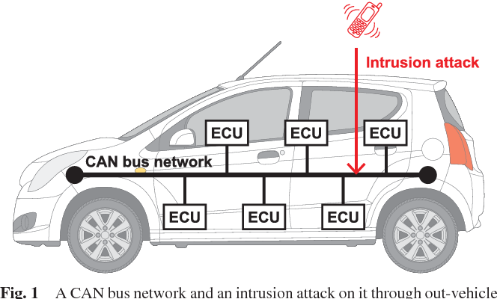
INTRODUCTION Controller Area Network (CAN)
one
CAN is designed for half-duplex and high-speed broadcast bus in-vehicular network, providing the communication rate up to 1Mbps
In the protocol, each ECU broadcasts a message to the network using a data packet.
Notes:
The lack of protection mechanisms in the CAN protocol permits attackers to control vehicle systems by injecting fabricated messages. For example, an attacker can change the gear of the car by injecting messages with the specific CAN identifier related to the gear function.
in recent years, various vulnerable features were discovered in vehicle systems, such as the electric window lift, warning lights, airbag [7], and tire pressure monitoring system (TPMS)
There are several studies that attempted to improve the security of the CAN protocol by adding digital signatures based on pair-wise symmetric secret keys [9], [10]. However, digital signatures have a high communication overhead, and the bandwidth of CAN is limited to 500 kbps.
Only one can communicate at a time. For example, a walkie-talkie is a half-duplex device because only one party can talk at a time

Slide 6
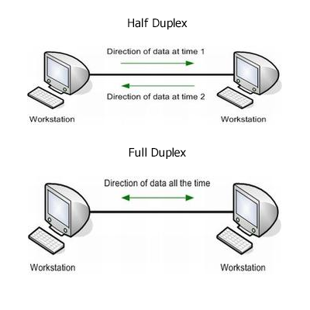
INTRODUCTION Controller Area Network (CAN)
CAN is designed for half-duplex and high-speed broadcast bus in-vehicular network, providing the communication rate up to 1Mbps
In the protocol, each ECU broadcasts a message to the network using a data packet.
Notes:
The lack of protection mechanisms in the CAN protocol permits attackers to control vehicle systems by injecting fabricated messages. For example, an attacker can change the gear of the car by injecting messages with the specific CAN identifier related to the gear function.
in recent years, various vulnerable features were discovered in vehicle systems, such as the electric window lift, warning lights, airbag [7], and tire pressure monitoring system
There are several studies that attempted to improve the security of the CAN protocol by adding digital signatures -→ bandwidth of CAN is limited to 500 kbps.
a walkie-talkie is a half-duplex

Slide 7
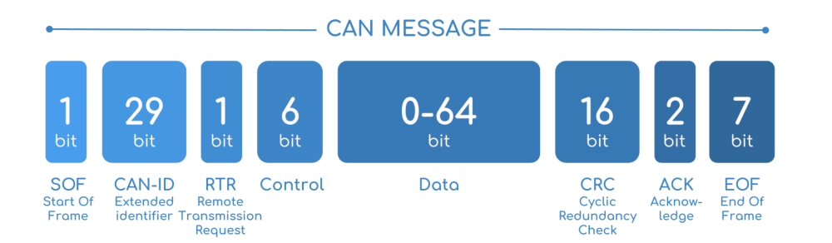
INTRODUCTION Controller Area Network (CAN)
CAN bus traffic is affected by these two types of attacking techniques: (1) attack on CAN packet frequency and (2) attack on CAN packet payload.
The controller area network (CAN) was developed as a message broadcast system to provide an efficient, reliable, and economical communication channel among ECUs.
CAN has no security features, such as authentication and encryption, to protect its communication from cyber-attacks
Notes:
Can ID includes an 11 bit ID field where each ID corresponds to a specific ECU
The ID field is used for a collision avoidance algorithm in the bus, which is extended to 29 bits.
The control field contains the size of the data field.
The data field contains maximum 8 bytes information to be transmitted in a message,
(CRC) field detects any error in the data packet. The acknowledgement field confirms the receipt of a valid CAN packet.

Slide 8
PREVIOUS WORK
The previous intrusion detection methods may be effective only for specific threat models in design stages
To cope with the problem machine learning based IDS techniques are employed
Several intrusion detection techniques are developed based on machine learning techniques, based on the assumption that the patterns of the attack packets differ from those of the normal packets
The advanced machine learning algorithms are barely used for a vehicular network because the computing power of the conventional ECU is limited to process the complex process. However, the computing power of ECU has been notably increasing to process enormous real-time tasks in the most recent vehicular system

Slide 9
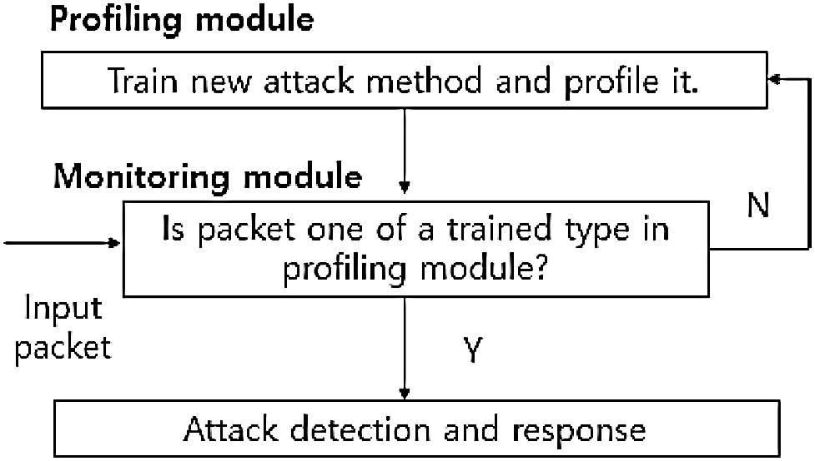
Intrusion Detection with Machine Learning
Monitoring module detects a type of an incoming packet after feature extraction
The profiling module contains the features trained off-line.
If the monitoring module identifies a new attack type, the profiling module may update the database of the profiling module for upcoming packets.
Notes:
the monitoring module detects a type of an incoming packet after feature extraction. The profiling module contains the features trained off-line. If the monitoring module identifies a new attack type, the profiling module may update the database of the profiling module for upcoming packets

Slide 10
Deep Architecture
discriminative deep architecture
The architecture can be categorized into two types
The discriminative deep architecture provides abilities for pattern classification with the supervised learning as in feed-forward artificial neural networks.
The generative deep architecture characterizing the correlation of the observed data and the associated classes is used for initializing parameters of the discriminative architecture called the unsupervised pre-training scheme
generative deep architecture
Notes:
Generatew --- can learn data distribution and after learning produce a new sample,,, can generate a data

Slide 11
DBN = Belief Network + RBM
Notes:
To understand Deep belief networks we need to understand two important definition : Belief Net
RBM : Restricted Boltzmann Machine

Slide 12
Boltzmann Machines
Boltzmann Machine is a network of symmetrically connected, that make stochastic decisions about whether to be on or off. Boltzmann machines have a simple learning algorithm that allows them to discover interesting features in datasets composed of binary vectors
No Direction;
Notes:
Undirect graphical. Model → undirected nodes
Fully connected between all nodes or nerouns
Each nerouns can get 0 or 1 value → stochastic binary unit
This model consists of hidden and visible layers( the data comes can visit in this part) unit
We want to train data in visible unit. Hoe to train? Find parameters to rich the distribution of the rtrain data near to our distribution
Bolz parameters are values between nodes(J → hidden L visible , w → hidden and hiddn)

Slide 13
Restricted Boltzmann Machines
Have both types of units
Visible neurons
Hidden neurons
Notes:
To use a simpe Boltzman , we should simplify the machine
For this remove the J and L weight (remove connection betw visible nad hidden layers)
Training with rest of weight

Slide 14
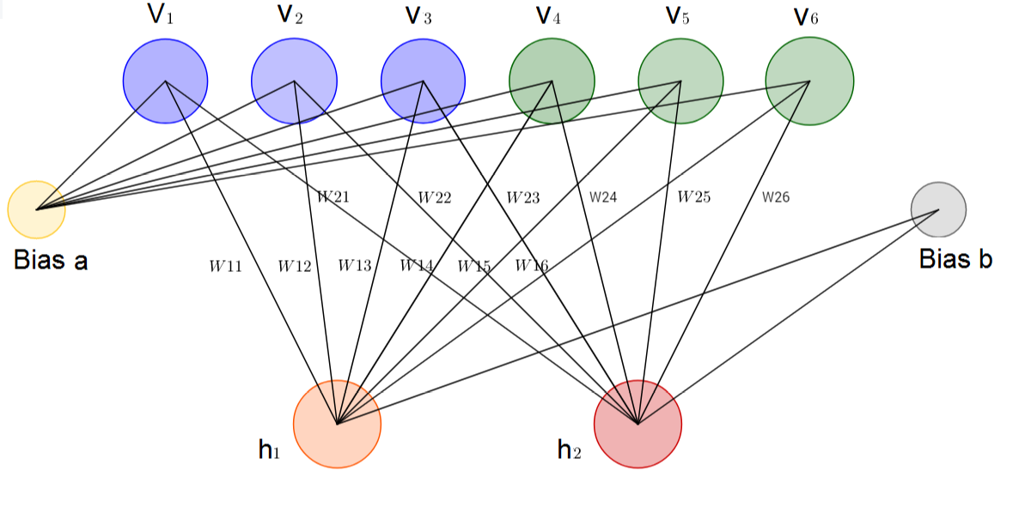
Restricted Boltzmann Machines
One input/visible layer (v1,…,v6), one hidden layer (h1, h2) and corresponding biases vectors Bias a and Bias b.

Slide 15
Deep Belief Network DBN
DBNs are class of deep neural network which composed of layers of Restricted Boltzmann Machines (RBMs) for the pre-train phase and then a feed-forward network for the fine-tune phase.
DBN is an Unsupervised Probabilistic Deep learning algorithm.
DBN is composed of multi layer of stochastic latent variables. Latent variables are binary, also called as feature detectors or hidden units
DBN is a generative hybrid graphical model. Top two layers are undirected. Lower layers have directed connections from layers above.
Application: Reconstruction and classification
Unsupervised training: Train a neural network with unlabeled data (cat)
Notes:
First learn RBM with some techniq .based on all training data we can find → extract fitures
Then make a new RBM based on these futures
We can build a hight level fatures base on first rbm
The concept of data is hight and accurate
------------
The first step of training DBN is to learn a layer of features from the visible units, using Contrastive Divergence (CD) algorithm. Then, the next step is to treat the activations of previously trained features as visible unites and learn features of features in a second hidden layer. Finally, the whole DBN is trained when the learning for the final hidden layer is achieved.

Slide 16
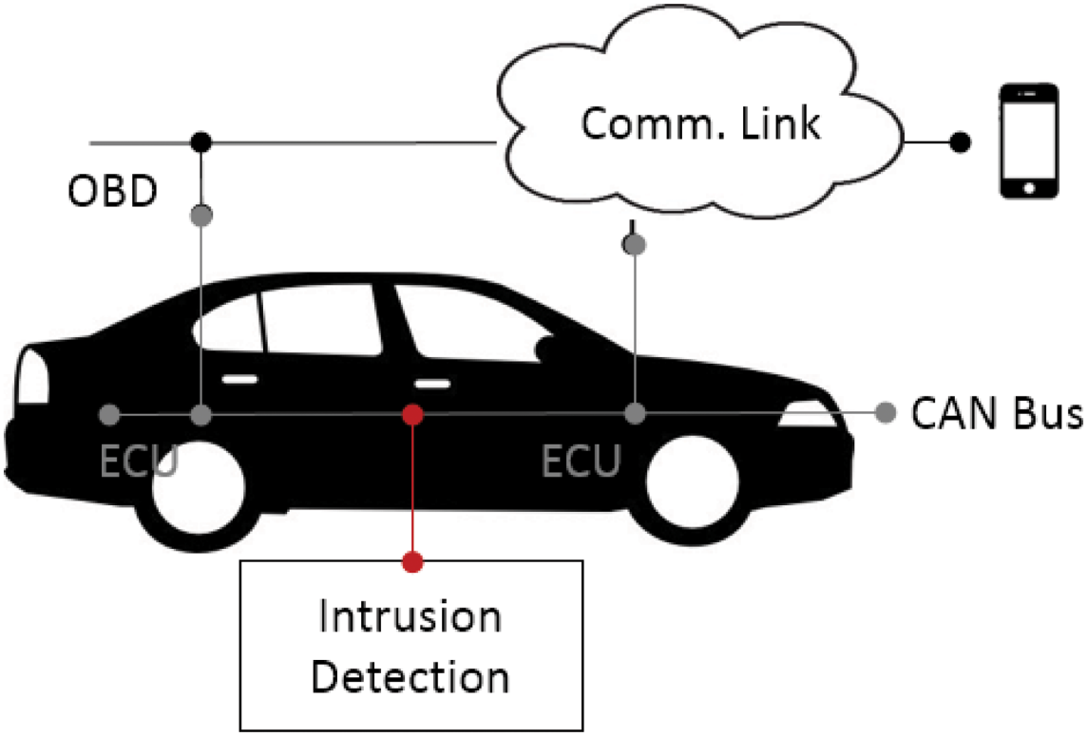
Proposed Intrusion Detection System with Deep Neural Network Structure
Considers a general type of an attack scenario where malicious data packets are injected into an in-vehicle CAN bus
system monitors broadcasting CAN packets in the bus and determines an attack
Notes:
Via mobile coomunication

Slide 17
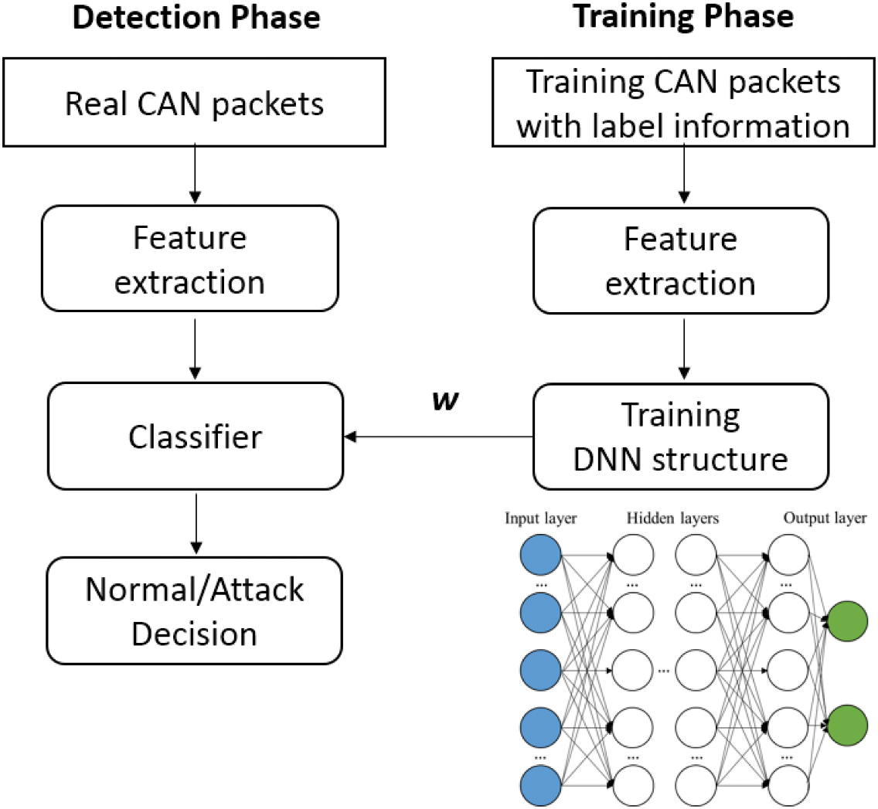
Proposed Intrusion Detection System
IDS design consists of two main phases
In the training phase a CAN packet is processed to extract a feature that represents a statistical behavior of the network
The same feature is extracted from an incoming packet through a CAN bus, and the DNN structure computes with the trained parameters to make the binary decision.
Notes:
Training is offline → time consuming
Each training CAN packet has its binary label, i.e., either a normal packet or an attack packet in supervised learning. features are expected to represent the label information.
We adopt the DNN structure to train the features, in which the weight parameters on the edges connecting the nodes are obtained

Slide 18
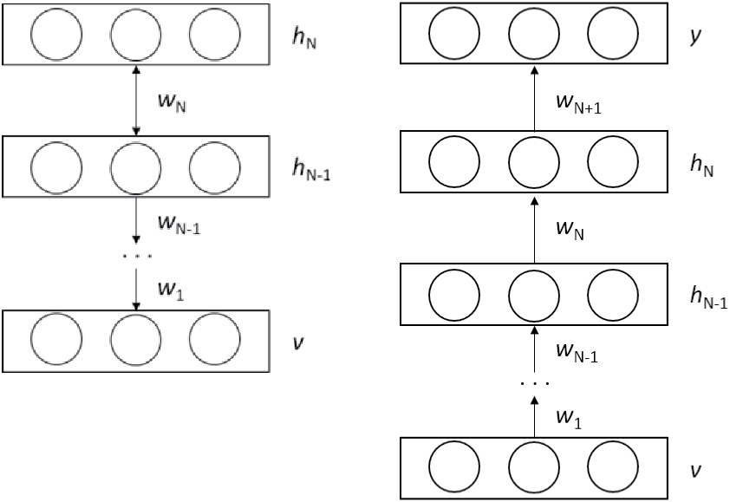
Proposed Intrusion Detection System
The learning structure should be configured as the DBN model
To this aim, the final classification layer including label information is added to the top layer of the DBN model to construct the deep learning structure.
fig.b shows The modified structure into the deep feed-forward ANN structure where the structure is trained with the bottom-up supervised learning manner , owing to the label information y
DBN structure with n hidden layers built with a top-down manner and (b) DNN structure involving the pretrained wight parameters in n hidden layers built with a bottom-up manner.
Notes:
. It is highlighted that the weights wi in the hidden nodes of the DBN structure are obtained from the unsupervised pre-training.
---However, the parameters are used only for initializing the weights, and, they are fine-tuned by using the gradient descent method in the deep feed-forward ANN structure later

Slide 19
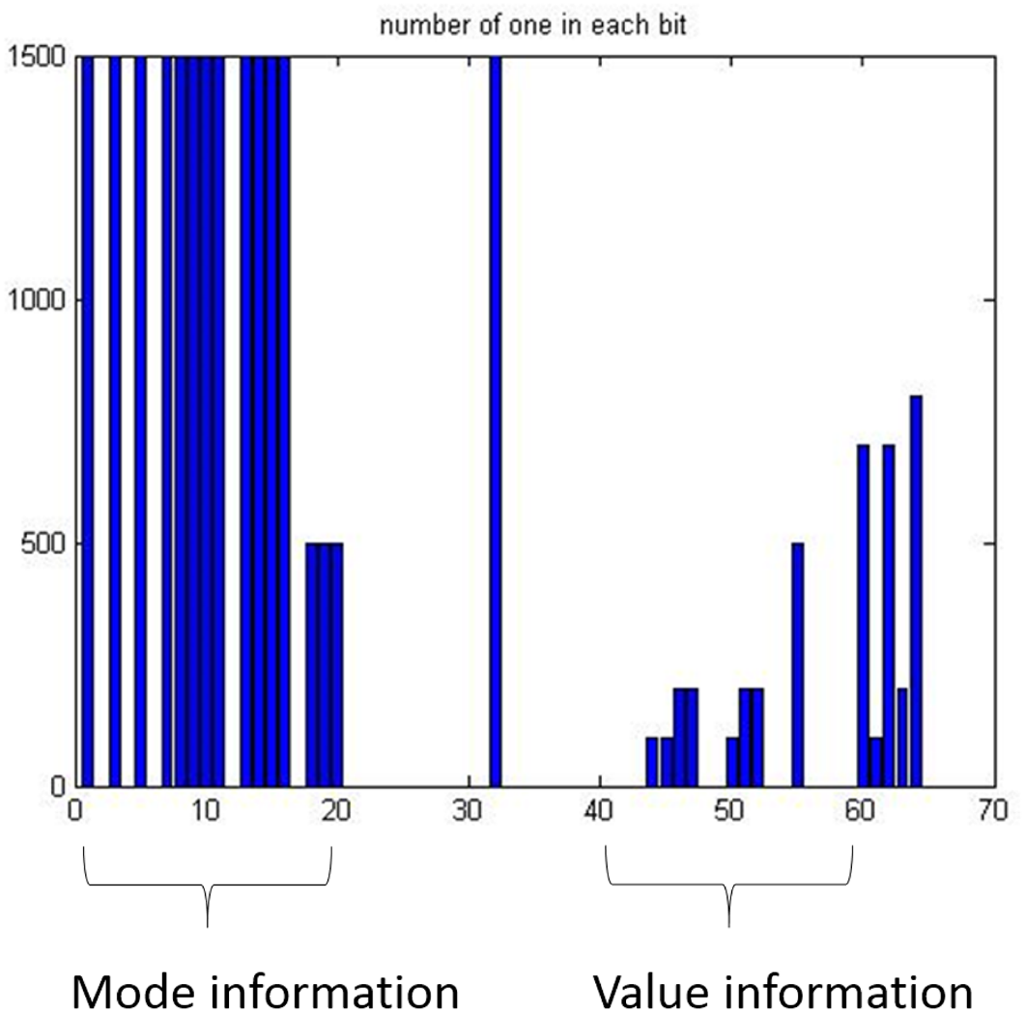
CAN Packet Feature
The proposed technique regards mode information and value information
The mode information represents a command state of an ECU,
the value information represents the value of the mode
value information is only used for the training phase. mode information used in the detection phase
Notes:
for example, controlling wheels
wheel angle or the speed,
The mode information is constant in a short period, while the value information may change with some noises
This picture show symbol 1 in the data field

Slide 20
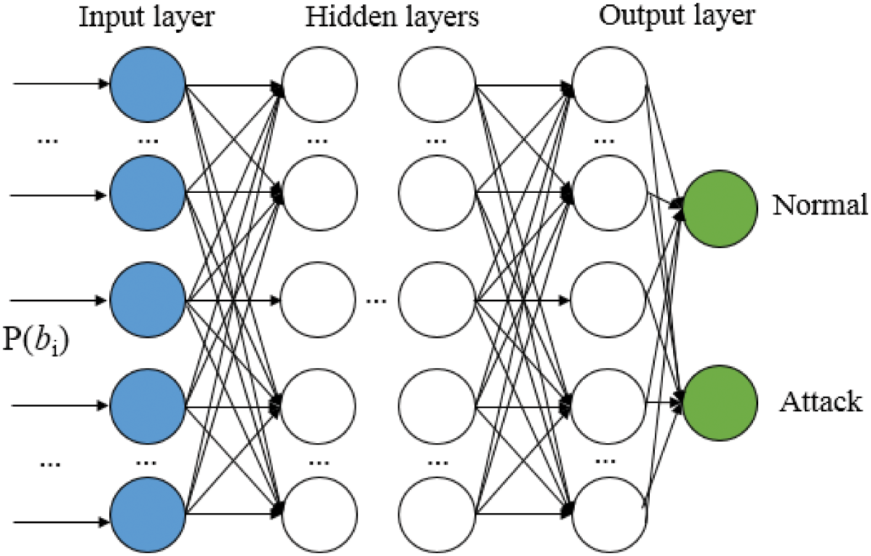
Training the Deep Neural Network Structure
The learning mechanism of the proposed DNN structure to classify a normal packet and an attack packet is explained
The feature vector (P) is inputted to the input nodes of the structure
An activation function using rectified linear unit (ReLU)
Notes:
Fig 7 shows an input layer, multiple hidden layers, and an output layer. The feature vector is inputted to the input nodes of the structure. Each node computes an output with an activation function using rectified linear unit (ReLU), and the linear combinations of the outputs are linked to the next hidden layers.

Slide 21
Attack Detection
The class of a testing CAN packet is predicted in the detection phase.
The output is computed with the trained weight parameters and the feature set extracted from the testing CAN packet as in the training.
The classifier provides the logistic value 0 or 1, telling if the sample is normal packet or the attack packet
The mode information is used for identifying the scenario in the proposed method, so that the appropriate training set can be applied.
Template matching is developed in the proposed method. The template comprising the mode information refers to the information along with the training samples used for the specific scenario.
Notes:
For this, template matching is developed in the proposed method. The template comprising the mode information refers to the information along with the training samples used for the specific scenario. Fig 8 shows an example of the template matching where the template is colored with yellow. As shown, if the template is matched between in the training sample and in the CAN packet to be tested, the detector uses the corresponding trained parameters obtained from the value information

Slide 22
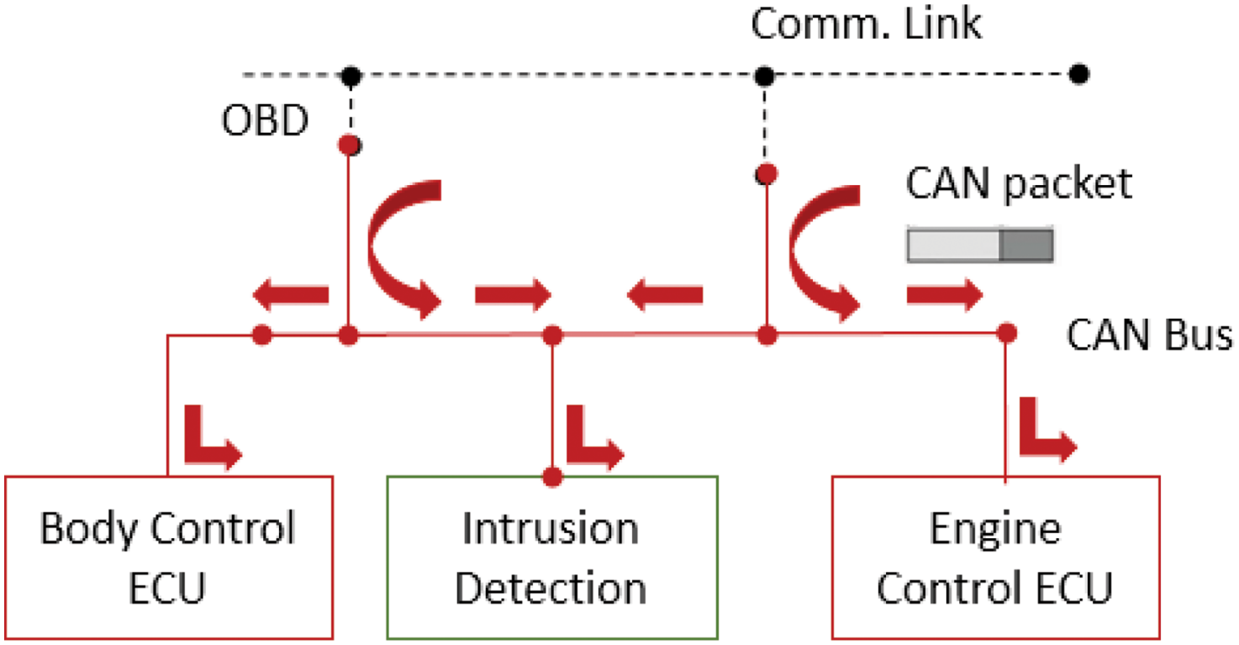
Experimental Results Dataset
The packets are created by the packet generator named Open Car Test-bed and Network Experiments (OCTANE)
The number of the generated packets is about 200,000 in a simulation.
To avoid the over-fitting problem, we assign 70% packets to the training data and 30% packets to the testing data
In the attack scenario some of the packets are injected and are manipulated to deceive the system. Note the attack packets are inserted with some time intervals, so that they are not burst in the in-vehicle network.
Notes:
Proposed IDS monitors the network packets

Slide 23
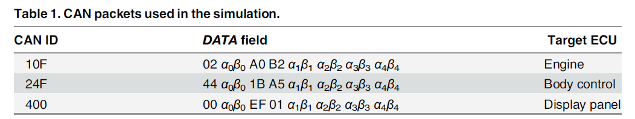
Experimental Results Dataset
CAN data packets considered in the experiment
The constant bit fields in the packet syntax are used for the mode information while the variables denoted by αi βi are used for the time-varying value information. Furthermore we add a Gaussian noise into the value information to give randomness.

Slide 24
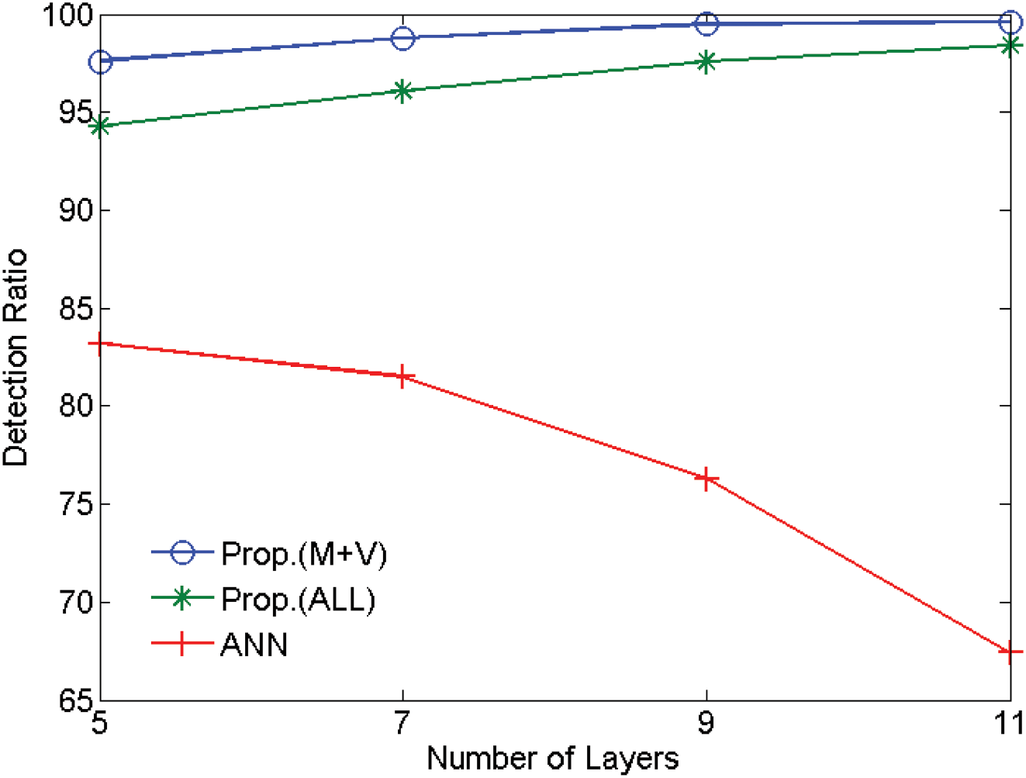
Conclusion
The total accuracy is about 97.8%
The ANN structure suffers from the vanishing gradient problem, causing the unstable performances with the number of the layers
DNN(M+V) is the best-performing method.
Notes:
Ann → lowest detection performances are observed when the number of the layer is 11
performance is monotonically increasing with the number of the layers
DNN(ALL) presents the proposed method using a feature including all the bits (64 bits) in the DATA field.
DNN(M+V) uses the feature including only the value information, i.e. αi βi in table

Slide 25
Conclusion
We trained the parameters of DNN with probability- based feature vectors extracted from the in-vehicular network packets by using unsupervised pre-training method of deep belief networks, followed by the conventional stochastic gradient descent method.
We also proposed a novel feature vector comprising the mode information and the value information extracted from the network packets, and they are efficiently used in the training and the testing. It was demonstrated with experimental results that the proposed technique could provide a real-time response to the attack with a significantly accurate detection ratio about 98% on average when the computational complexity with the number of the layers is modestly small.

Slide 26
Conclusion
an intrusion detection system using the deep neural network (DNN) structure is proposed to secure the in-vehicular network.
The proposed technique trains high-dimensional CAN packet data after the dimension reduction to figure out the underlying statistical properties of normal and attack packets, and, in defense, it extracts the corresponding features to identify the attack.
This work is the first to employ the deep learning structure in the IDS of in-vehicular networks, which differs from earlier ANN-based intrusion detection methods
Unsupervised deep belief network (DBN) pre-training methods to efficiently train the parameters initializing the deep neural network. The parameters are tuned later to achieve a better classification result with the supervised learning.
Experimental results demonstrate that the proposed method yields a superior performance in terms of a classification error with little computation complexity in the decision.

Slide 27
References
1. Park T, Han C, Lee S. Development of the electronic control unit for the rack-actuating steer-by-wire using the hardware-in-the-loop simulation system. Mechatronics 2015; 15: 899–918. doi: 10.1016/j. mechatronics.2005.05.002
2. Tuohy S, Glavin M, Hughes C, Jones E, Trivedi M, Kilmartin L. Intra-Vehicle Networks: a review. IEEE Trans. on Intelligent Transportation Systems 2015; 2: 534–545. doi: 10.1109/TITS.2014.2320605
3. Biswas S, Tatchikou R, Dion F. Vehicle-to-vehicle wireless communication protocols for enhancing highway traffic safety. IEEE Signal Processing Magazine 2006; 44: 82–97.
4. Fan Y, Dao L, Crolla DA. Integrated vehicle dynamics control state-of-the art review. Vehicle Power and Propulsion Conference 2008.

Slide 29
CAN Packet Feature
The proposed technique regards mode information and value information
The mode information represents a command state of an ECU,
the value information represents the value of the mode
value information is only used for the training phase. mode information used in the detection phase
Notes:
for example, controlling wheels
wheel angle or the speed,
The mode information is constant in a short period, while the value information may change with some noises
This picture show symbol 1 in the data field

Slide 30
Appendix

Slide 31
Kang and Kang [24] proposed the use of an unsupervised DBN to train parameters to initialize the DNN, which yielded improved classification results (exact details of the approach are not clear). Their evaluation shows improved performance in terms of classification errors
in [5] represents an interesting detection approach based on Deep Neural Network, its high computational cost render it clearly unsuitable for modern vehicles.

Slide 32
In [13], Kang et al. proposed an intrusion detection technique using a deep neural network (DNN). The authors trained the DNN via a great number of valid CAN frames and tested the CAN frames with the trained DNN. In the experiment, 3900 frames were tested in only 7 to 8 milliseconds, and 99.8 percent of the hacking frames were detected when the DNN contained five layers.

Slide 33
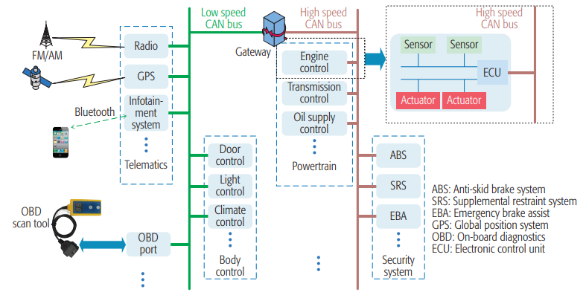

Slide 34
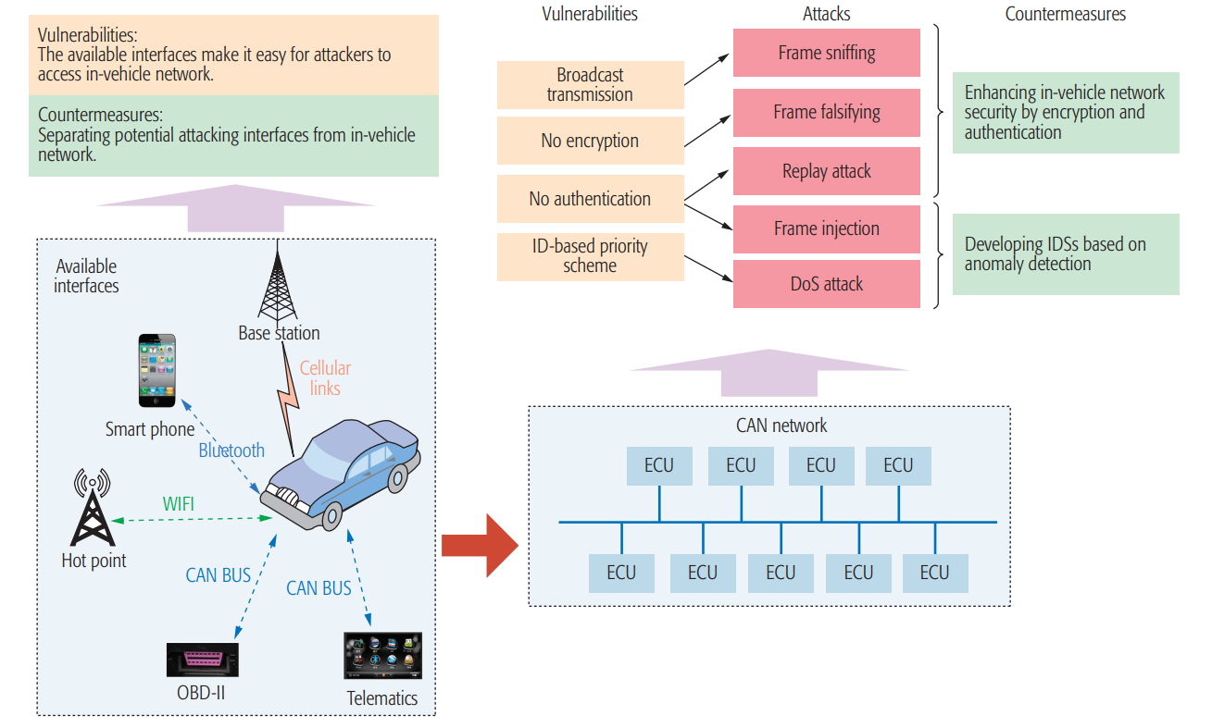

Slide 35
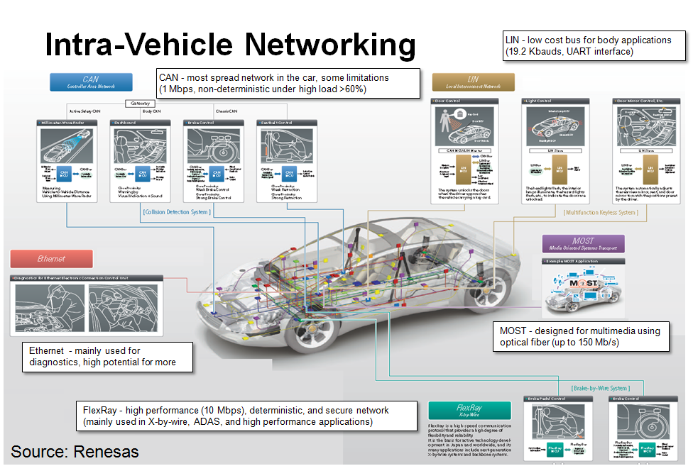

Slide 36
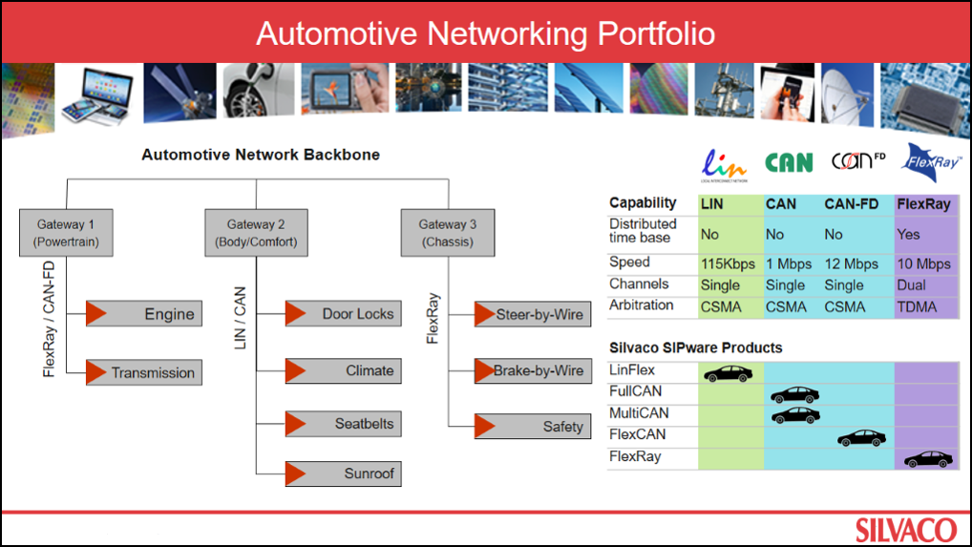

Slide 37
CAN Packet Feature
The proposed technique regards mode information and value information
The mode information represents a command state of an ECU,
the value information represents the value of the mode
value information is only used for the training phase. mode information used in the detection phase
Notes:
for example, controlling wheels
wheel angle or the speed,
The mode information is constant in a short period, while the value information may change with some noises
This picture show symbol 1 in the data field

Slide 38
What is wrong with back-propagation?
• It requires labeled training data. –Almost all data is unlabeled.
• The learning time does not scale well – It is very slow in networks with multiple hidden layers.
• It can get stuck in poor local optima.

Slide 39
They mean the same thing in machine learning - training a model is the act or process of fitting that model to data, or “learning something” about the underlying data generating process, i.e., acquiring knowledge from or extracting “structure” from the data. The idea is that the model you use on the data will pick up interesting patterns in the sample that will be useful for not only predicting the training sample accurately (i.e., an optimization goal - near 0 training error) but will generalize out-of-sample (i.e., the statistical learning goal - predict well on unseen data samples).
[Note: After reading this answer, you now have three ways to say roughly the same thing - “learning from data” = “training a model” = “fitting a model to data”.]

Slide 40
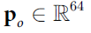
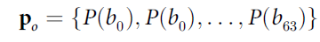
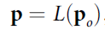
CAN Packet Feature
the feature is extracted directly from a bit stream of a CAN packet so that the decoding is not necessary during the extraction
where P(bi) is the probability of a bit-symbol “1” observed in the i-th bit position, and
Notes:
CAN feature is an abstract representation of a CAN packet. The feature is designed by considering computational efficiency. In other words, the feature is extracted directly from a bitstream of a CAN packet so that the decoding is not necessary during the extraction. The occurrences of bit-symbols in a data packet are taken into an account. In particular We choose the DATA field that includes 64 bit positions (= 8 Bytes) in the CAN syntax and investigate the probability distributions of the bit-symbols. Mathematically the data vector

Slide 41
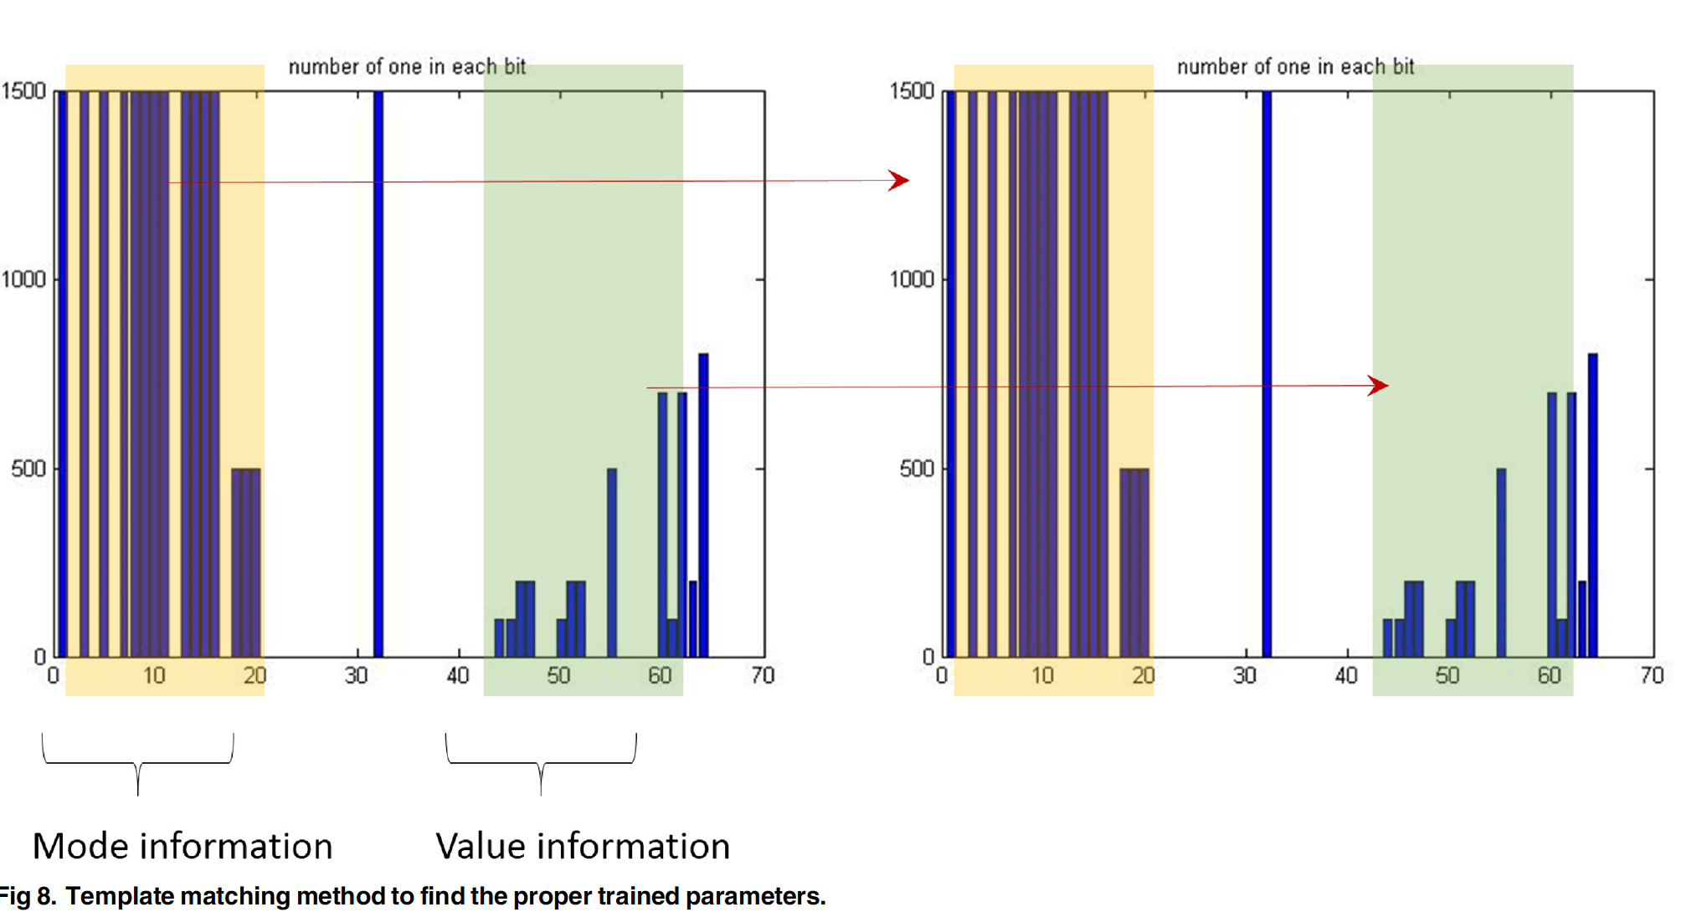
An example of the template matching where the template is colored with yellow
if the template is matched between in the training sample and in the CAN packet to be tested, the detector uses the corresponding trained parameters obtained from the value information

